Slide 1
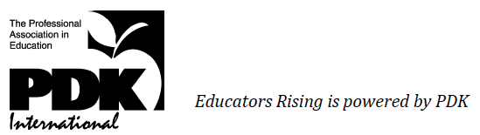
EDUCATORS RISING
Addressing Equity with Recruitment Pipelines
Dan Brown, NBCT
Co-Director, Educators Rising

Slide 2
21st Century Grow-Your-Own Pipelines
Recruitment is a community workforce development issue.
Most teachers are homegrown. Over 60% of teachers work within 20 miles of where they went to high school.
Let’s start early–in secondary–and start with quality to help communities grow their own.

Slide 3
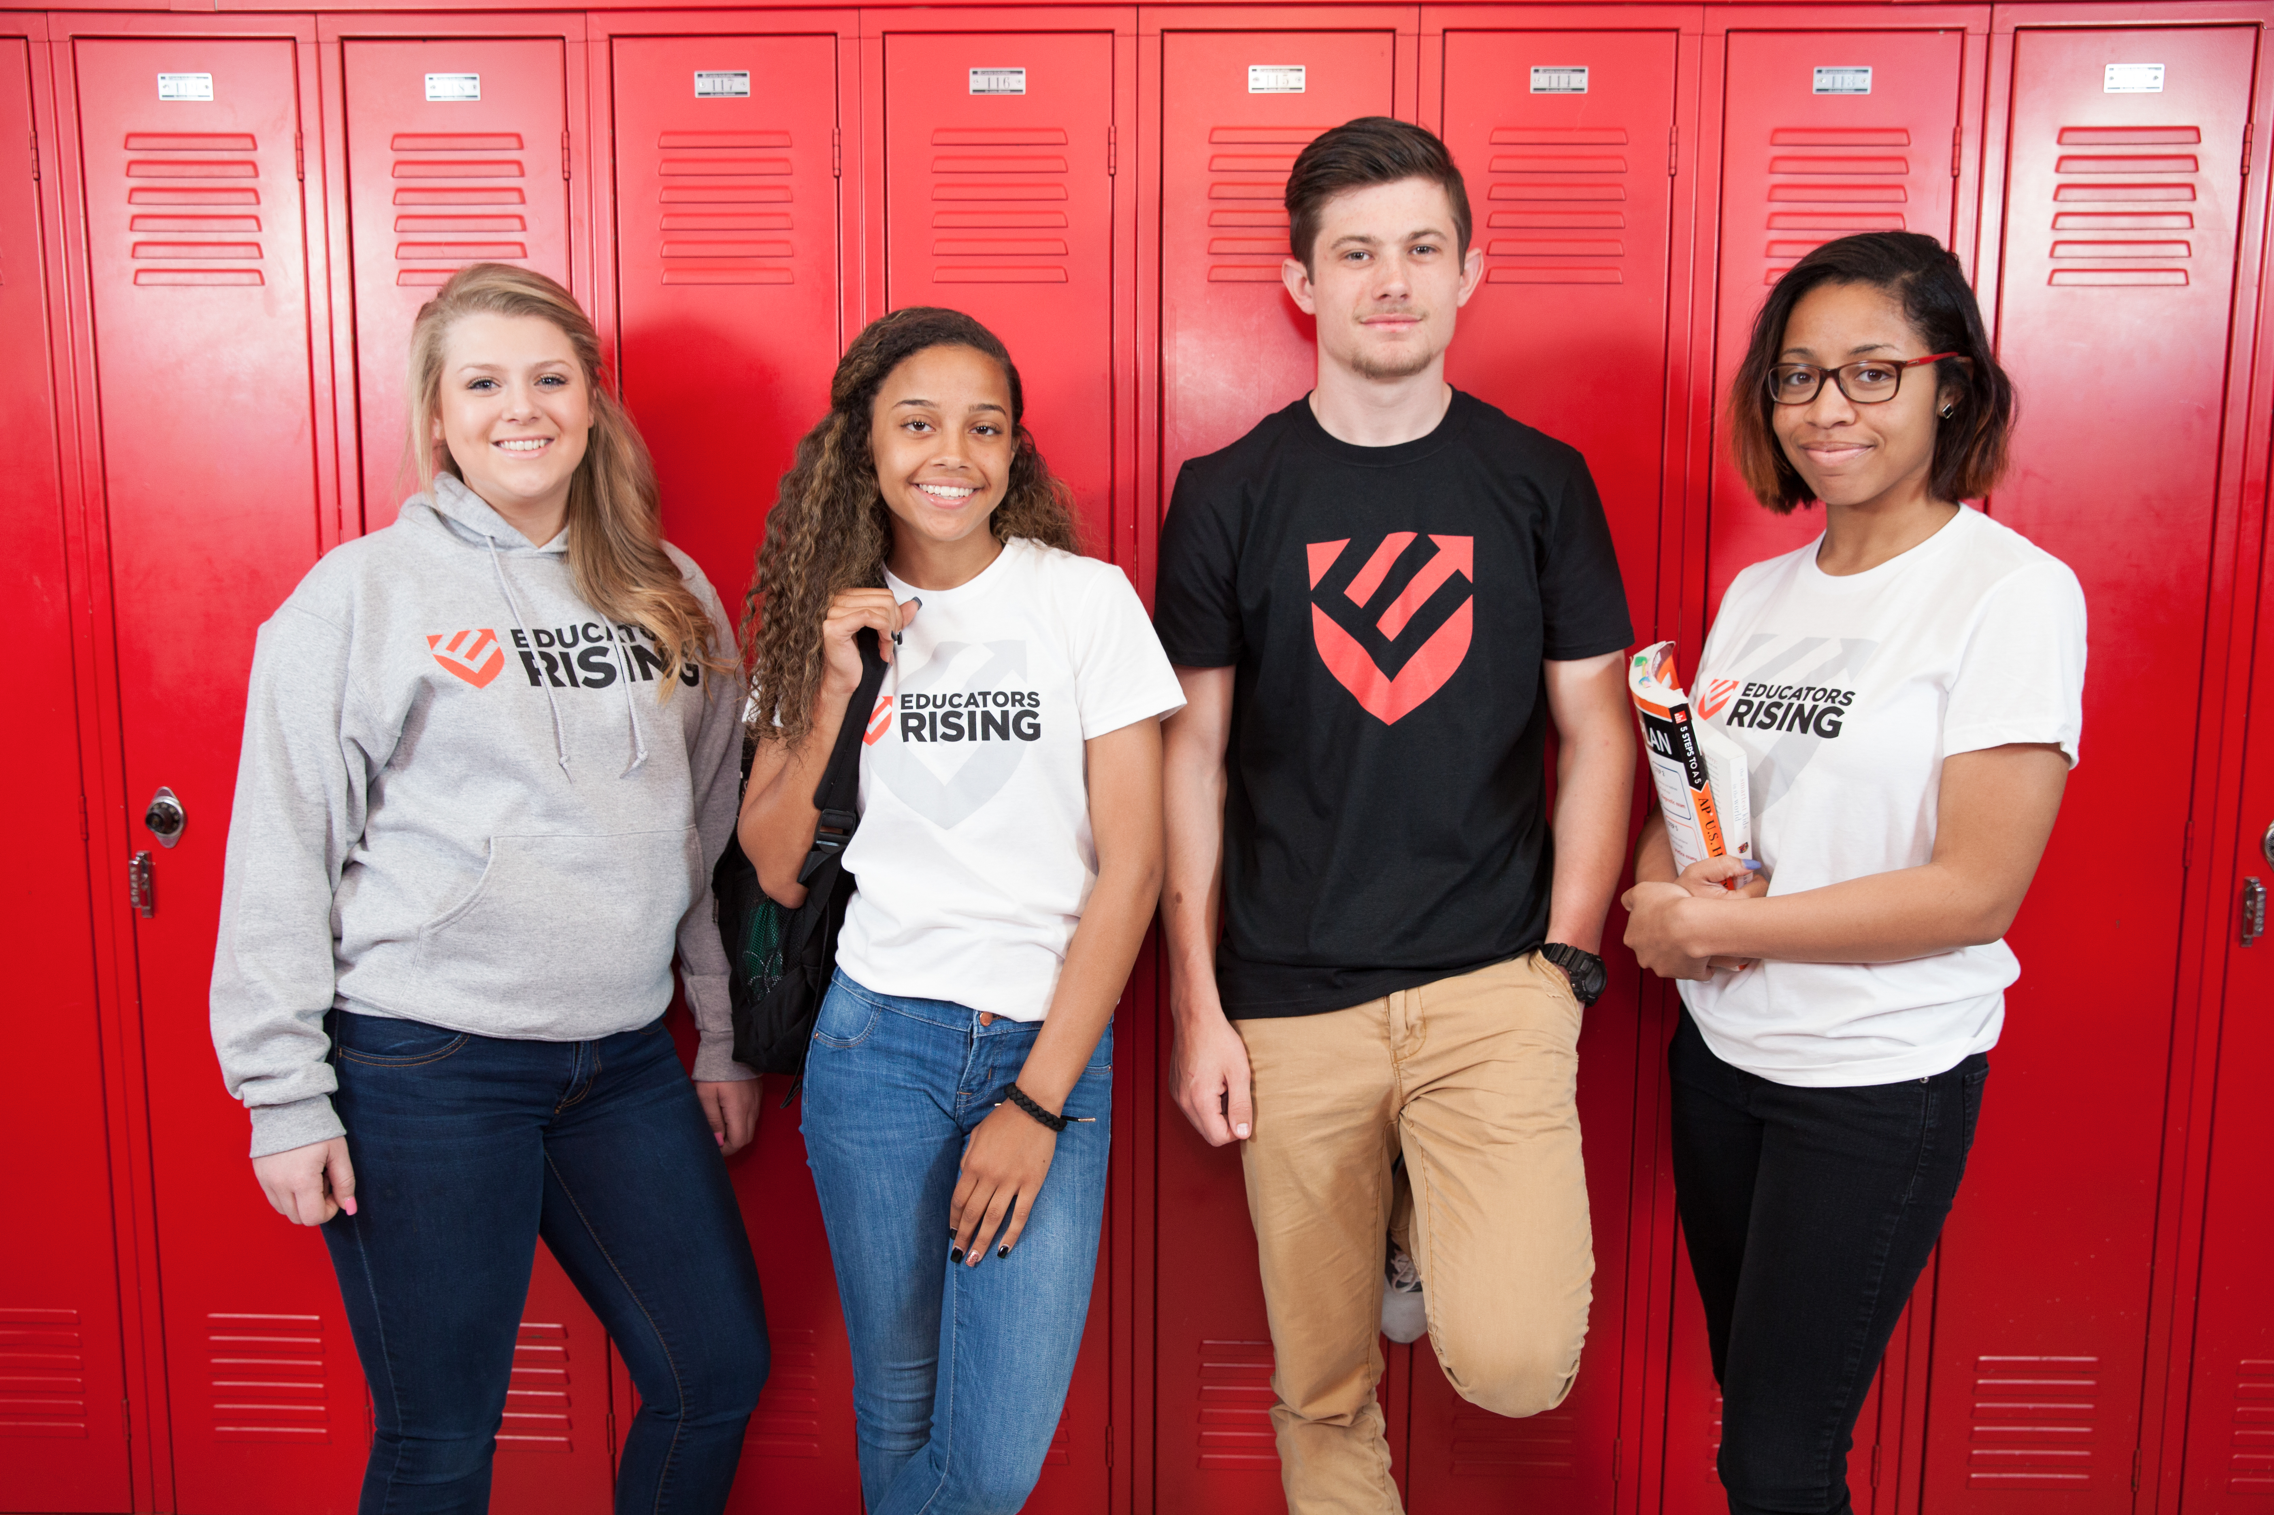

Slide 4
Mission & Vision
Mission
Educators Rising cultivates highly skilled educators by guiding young people on a path to becoming accomplished teachers, beginning in high school and extending through college and into the profession.
Vision
Every teacher in America has the skills and experience to help all students achieve their potential.

Slide 6
Educators Rising Academy Project
Building a Grow-Your-Own Model
Standards (NBPTS partnership)
What do 16-, 17-, and 18-year-old aspiring educators need to know about and be able to do to be on the road to great teaching?
Curriculum
How can schools and teacher leaders deliver a high-quality 1-year or 2-year cocurricular program with clinical experience?
Micro-credentials (Digital Promise partnership)
How can we recognize and incentivize to accumulate key competencies on the road to great teaching?
Teacher Leader Training / Implementation Support
How can we provide online and offline support to schools and teacher leaders to ensure quality and sustainability in grow-your-own programs?

Slide 7
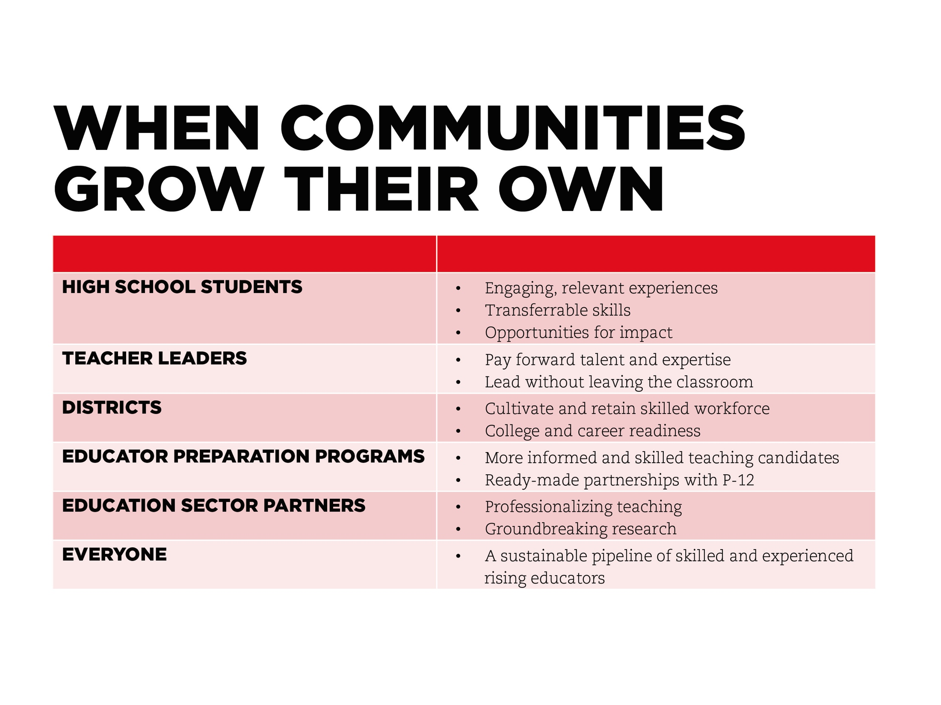

Slide 8

Let’s keep in touch. There’s power in teaching.
dan@educatorsrising.org
www.educatorsrising.org

