Slide 1
SEA Strategies for Promoting Equity: SEA/IHE Collaboration on Teacher Preparation Lynn Holdheide, Center on Great Teachers and Leaders & Collaboration for Effective Educator Development Accountability, and Reform (CEEDAR) Center
Promoting Equitable Access at the State and Local Levels
SECC/TXCC Regional Institute
November 5 and 6, 2015

Slide 2
Today’s Objectives
Participants will
Recognize that teacher and leader preparation can play a significant role in equitable access.
Have knowledge about strategies states and districts can take to leverage preparation programs to impact equitable access to excellent educators.
Explore and potentially strengthen current state and district efforts to collaborate with preparing programs to address recruitment and retention.
Gain awareness of state and district efforts to improve teacher and leader preparation policy and practice that may positively affect equity.

Slide 3
What Is an Effective Teacher?
Take a moment to define or describe an effective teacher from the following perspectives:
In your current role…..
In your role as a parent….
In your role as a student….
Notes:
Before we begin, I want you to take a moment and provide a response to the following stems. In your packet you have a response sheet if you are inclined to use it. But I want you to answer how you would define an effective teacher in the role you’re are currently in, your role as a parent if you are one, and you role as a student. What are the characteristics and skills sets that teachers have that define effectiveness.
Take just 1-2 minutes.
Are you answers the same, similar, or completely different? Has it changed over time? Does the difference matter?
can tell you as a parent I have had the pleasure of experiencing teachers – both effective and not – across a number of reform initiatives. Each role I play provides a perspective on the effectiveness of our work. A good example…. Joe – educator evaluation

Slide 4
Equitable Access to Effective Teachers
Students who have “equitable access” to education will have:
Teachers who are experienced.
Teachers who are qualified.
Teachers who are placed in a field in which they have certification.
Teachers with “proficient” ratings on the teacher evaluation system.
Notes:
Surr, Wendy 10/21/2015
SO a lot of my work in the last 10 or so years of my career have been related to educator evaluation and effectiveness. Now we are experiencing a swing toward equitable access to excellent or effective teachers. Just a thought about whether you want to insert before this slide that these days the focus and measure of success for many is college and career readiness. AND that deeper learning competencies (listed) is what we hope our students will achieve so they are in fact college and career ready. This is a goal for all of our students--and thus the focus on equity. This slide: How we are currently defining "effective" may not yet be well aligned with our goals for students. We are currently determining if teachers are "effective" by measures that have been proven to have little relationship to teacher performance or student outcomes.

Slide 5
Vision for an Excellent Educator Workforce
Effective Veteran Teachers
Support Personnel
District Administrators
Building Administrators
Novice Teachers
Counselors

Slide 6
How Do We Get There?
Connect and align state, district, and preparation program efforts.
Build educator capacity at all levels (e.g., state education agency, institute of higher education, and local education agency).
Tap into leverage points throughout the educator career continuum.
Notes:
Guiding principles
>> Be embedded within a holistic educational vision and supported by a school culture—including
professional development, curricular freedom, and other structures—to ensure their success.
>> Be applied to groups of educators or whole school teams. >> Align with similar efforts to describe student competencies, system leader competencies, and
system characteristics for deeper learning. >> Focus on knowledge, mindsets, and skills that go beyond general “good teaching” practices
to emphasize areas that comprise successful approaches in personalized, learner-centered
settings. Far from it. Instead, this framework deliberately builds a bridge from
those foundations toward a vision of how the teaching profession can evolve to meet the changing
needs of learners.

Slide 7
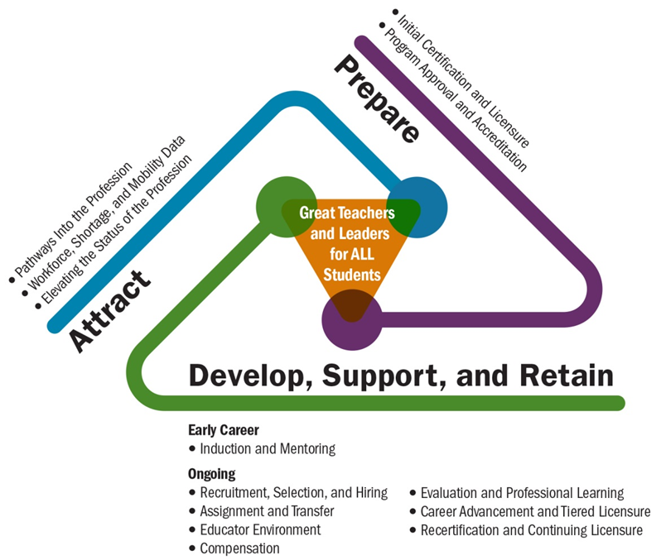
Leverage Points
What role does teacher and leader preparation play?
What role can the state education agency play?

Slide 8
Workforce, Shortage, and Prediction
Supply and Demand/Pipeline
How well does the state, districts, and the preparing programs understand the district shortages?
How well does the state and districts collaborate with the preparing programs to create the pipeline needed?
Has or can the state create incentives for recruitment into shortage areas?
Can the preparing programs create certification pathways that encourage and entice educators toward certain shortage areas?
Notes:
the Competencies offer an interpretation of how
to translate standards within the context of personalized, student-centered learning models

Slide 9
Workforce, Shortage, and Prediction
Supply and Demand/Pipeline
How well does the state, districts, and the preparing programs understand the district shortages?
How well does the state and districts collaborate with the preparing programs to create the pipeline needed?
Has or can the state create incentives for recruitment into shortage areas?
Can the preparing programs create certification pathways that encourage and entice educators toward certain shortage areas?
Notes:
the Competencies offer an interpretation of how
to translate standards within the context of personalized, student-centered learning models

Slide 10
Workforce, Shortage, and Prediction
http://c3ta.org/files/Missouri_Highlighted_Project_Educator_Shortage_Model.pdf
Notes:
the Competencies offer an interpretation of how
to translate standards within the context of personalized, student-centered learning models

Slide 11
Leverage Points
What role does teacher and leader preparation play?
What role can the state education agency play?

Slide 12
Prepare
Teacher and leader standards
How well are the skills educators need to be successful at supporting all student learning reflected within the teacher and leader standards?
For example, is the expectation established through the standards for educators to have both deep content knowledge and pedagogy to support all student learning?
How well are the skills leaders need to create positive working conditions and safe and supportive cultures reflected within the teacher and leaders standards?
For example, is the expectation established through the standards for leaders to have both deep content knowledge and demonstrated experience building and sustaining a supportive culture and positive working conditions?
Notes:
the Competencies offer an interpretation of how
to translate standards within the context of personalized, student-centered learning models

Slide 13
Prepare
Certification and licensure standards
Are teacher and leader candidates required to demonstrate their capacity to support the learning of all student populations?
For example, as part of the certification process, do teacher candidates submit lesson plans, activities, and assessments that demonstrate an understanding of all student learning and strategies to promote achievement?
Do the certification and licensure standards create pathways for reciprocity in licensure across states?
Notes:
Use a mastery approach to learning.
INDICATORS:
a. Build curriculum units from essential questions, recognized standards, school-wide, and/or subject specific
competencies, and/or real-world problems to be solved.
b. Determine students’ progress, advancement, and pace via various methods of demonstrated
understanding of the content, skills, and application of learning goal.
c. Customize and scaffold instruction, supports, and pacing so that all learners can master the
content and fill gaps in understanding.
d. Maintain a focus on high expectations for achievement while providing feedback and opportunities
for practice, revision, and improvement.
Use assessment and data as tools for learning.
INDICATORS:
a. Apply the use of data (quantitative and qualitative) systematically to understand individual skills,
gaps, strengths, weaknesses, interests, and aspirations of each student, and use that information
to design and modify personalized learning paths toward meeting school, district, and state
standards.
b. Use multiple, frequent, and formative assessments —such as self-assessment, exit tickets, and
student surveys—in a timely manner to engage learners in their own growth, to monitor learner
progress, to guide educators’ and learners’ decision making, and to communicate with families.
1
2
Skills in the INSTRUCTIONAL DOMAIN
describe what personalized, learner-centered
educators need to do to bring distinctly
learner-centered pedagogical techniques
into the classroom. These include creating
engaging and relevant curriculum, managing
classroom dynamics, and using instructional
approaches and methods that build toward
and assess mastery.
THE EDUCATOR COMPETENCIES THE EDUCATOR COMPETENCIES | INTRAPERSONAL DOMAIN THE EDUCATOR COMPETENCIES
JOBS FOR THE FUTURE AND THE COUNCIL OF CHIEF STATE SCHOOL OFFICERS 17
c. Facilitate students’ creation of a portfolio, exhibition, or other public showcase tool to serve as a
culminating event at appropriate educational junctures.
d. Develop, use, and involve the students in the creation of assessment tools that are flexible and
that clearly articulate standards and criteria for meeting those standards.
Customize the learning experience.
INDICATORS:
a. Recognize and integrate knowledge of individual learners, diverse cultures, and the community
context in developing materials and pedagogy to ensure inclusive learning environments that
enable each learner to meet rigorous standards.
b. Co-construct and offer choice among multiple means for students to demonstrate mastery.
c. Scaffold, customize whenever possible, and provide adequate supports and interventions to
appropriately stretch each learner, informed by teacher expertise.
d. Document and track learning trajectories that meet each learner’s readiness, strengths, needs,
and interests.
i. Update and refine pre-existing individual learning plans or co-design an individual learning
plan with each student and family as necessary.
ii. Use the plan to build effective individual and collective learning experiences.
e. Use technology to lessen the burden of tracking student progress, finding materials, engaging
learners in different ways, and offer academic supports.
Promote student agency and ownership with regard to learning.
INDICATORS:
a. Encourage student voice and choice via strategies such as:
i. Providing access for students to monitor their progress and set goals.
ii. Enabling curricular choice and co-design.
iii. Providing students with multiple options for demonstrating mastery of a standard or
competency.
iv. Providing opportunities for students to contribute to classroom or school-based decisionmaking
processes, including participatory action research, place-based education,
restorative circles, and class meetings.
b. Develop students’ abilities to self-reflect and self-regulate via strategies such as goal setting, selfassessment,
and self-pacing.
3
4
18 EDUCATOR COMPETENCIES FOR PERSONALIZED, LEARNER-CENTERED TEACHING
c. Develop students’ abilities to collaborate with peers via strategies such as peer assessment and
project-based learning.
d. Cultivate students’ growth mindsets.
e. Help students manage their own behavior to optimize the learning environment for all.
f. Engage in and positively influence students’ perceptions of their efficacy, interest, and purpose.
Provide opportunities for anytime/anywhere and real-world learning tied to
learning objectives and standards.
INDICATORS:
a. As described in the interpersonal competencies, build relationships with families, community
members, businesses, and others outside of the school to support communities of practice that
enhance individual and group student learning.
b. Align out-of-school experiences to the relevant academic competencies or standards, so that
students may demonstrate mastery and receive in-school credit based on these out-of-school
experiences.
c. Demonstrate fluency with the curricular and personal aspects of providing a successful
blended learning experience.
d. Develop diverse physical and digital environments that maximize learning within, across,
and beyond classrooms.
Develop and facilitate project-based learning experiences.
INDICATORS:
a. Engage learners and other faculty in co-designing projects that stretch and deepen the learning
experience.
b. Use collaborative, cross-curricular projects to develop learners’ deep understanding of content
areas, connections to applications beyond school, and skills to apply knowledge in meaningful
ways.
c. Emphasize regular student reflection about specific questions that draw out the learning within
the project.
5
6
INTERPERSONAL DOMAIN THE EDUCATOR COMPETENCIES | INSTRUCTIONAL DOMAIN
JOBS FOR THE FUTURE AND THE COUNCIL OF CHIEF STATE SCHOOL OFFICERS 19
7
8
Use collaborative group work.
INDICATORS:
a. Develop, scaffold, facilitate, and where appropriate co-design collaborative group work.
b. Analyze collaborative group work to ensure that it engages and stretches each learner and builds
toward mastery of specific skills, standards, or student competencies.
c. Foster students’ ability to identify specific teamwork skills necessary for collaborative group work
that are similar to the skills and dispositions necessary for college, career, and civic success.
d. Ensure students have developed the knowledge and skills needed for successful collaborative
group work:
i. clearly defined roles, purpose of collaborative group work, and understanding of
assessments
ii. establishing structures for and practicing how to share ideas and benefit from ideas and
skills of others
iii. practice in tools and techniques such as Socratic questioning and constructive feedback.
Use technology in service of learning.
INDICATORS:
a. Adopt, adapt, and create high-quality digital resources for curriculum.
b. Enhance ability to provide real-time assessment and learning tracking with new digital tools.
c. Employ the principles of universal design for learning.
d. Provide opportunities for all students to learn in a digital setting (synchronous and asynchronous).
e. Promote the development of “digital fluency” in students to enhance their ability to interact in our
digital world.
f. Discern when technology use in instruction improves engagement, collaboration, and learning, and
when it does not.
g. Promote collaborative and real-world project-based learning opportunities enhanced with digital
tools and content.

Slide 14
Certification and Licensure
Multiple tiers–multiple paths
Aligning tiers with compensation
http://www.gtlcenter.org/sites/default/files/Tiered_Licensure.pdf

Slide 15
Prepare
Program approval
Do the state program approval requirements include expectations for both coursework and field experiences that incorporate experiences working in a range of contexts, service delivery models, and with a diverse range of students?
For example, do the field experiences include deliberate opportunities to apply instructional strategies for supporting all student learning that is paired with coaching and feedback?
Do the state program approval requirements include expectations for local education agency partnerships?
Do the state program approval requirements include expectations that programs reflect local district needs in terms of pipeline needs and needed capacity?

Slide 16
Program Approval
Revised regulations:
require educator preparation programs to work in partnership with districts and schools to support the needs of the districts and inform educator preparation program effectiveness;
ensure that educator preparation programs focus recruitment, retention, and preparation efforts on preparing educators for high-need placements in Massachusetts;
emphasize the need for a stronger clinical component in preparing educators
http://www.doe.mass.edu/edprep/ProgramApproval.pdf

Slide 17
CEEDAR and Equity Connection Prepare
Certification and Licensure
Teacher and leader standards revision to reflect evidence-based practices, Universal Design for Learning (UDL), and differentiated instruction
Revision to professional licensure examinations to ensure educators demonstrate capacity to use UDL as a framework for designing differentiating instruction and designing classroom-based assessments
Program Approval and Accreditation
Revision of program approval processes to require clinical experience supporting students with disabilities and other diverse learners
Integration of outcomes for students with disabilities into the accountability process for all programs across all educators

Slide 18
CEEDAR and Equity Connection Develop, Support, and Retain
Recertification and Continuing Licensure
Revision to recertification policy to leverage timing and needed expertise via context.
Microcredentialing use within recertification to develop specific competencies.
Multitiered licensure to develop an increase in expertise within tiered levels of support (e.g., multi-tiered systems of support, response to intervention).
Evaluation and Professional Learning
Alignment of expectations between preservice and inservice.

Slide 19
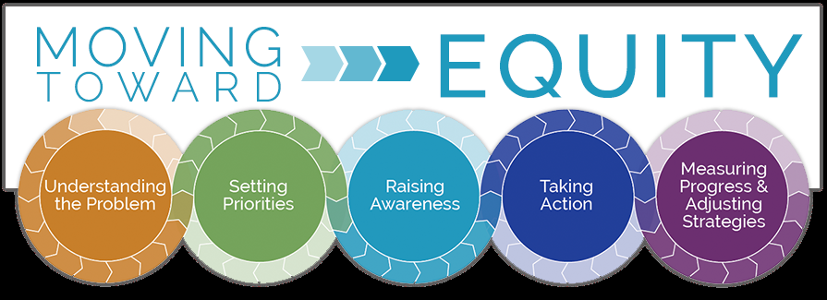
Develop, Support, and Retain
The key to retention is building educator confidence and capacity.
Through-line: Increased Educator Capacity
Notes:
By having a stronger sense of competence, teachers will be more willing to take on challenges, will persevere, and will be motivated to continue to grow, adapt, and thrive in our changing educational landscape.

Slide 20
Lynn Holdheide
1000 Thomas Jefferson Street NW
Washington, DC 20007-3835
615-308-2525
lholdheide@air.org
gtlcenter@air.org
www.gtlcenter.org | www.air.org

